Slide 1
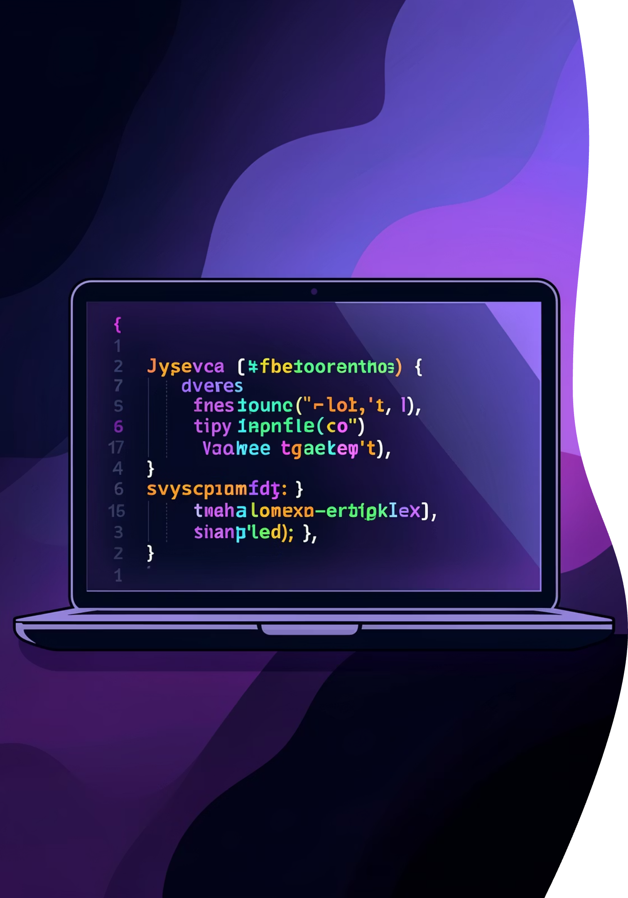
JavaScript Essentials for Beginners
Master the fundamental building blocks of JavaScript programming with clear examples and practical guidance

Slide 2

CHAPTER 1
Variables: Storing Your Data
Variables are containers that hold data values in JavaScript. Think of them as labelled boxes where you store information for later use.
Three Ways to Declare
var – function scoped, the older approach
let – block scoped, recommended for most cases
const – block scoped, for values that won't change

Slide 3
Variable Declaration in Action
let age = 25;
const name = “Saurabh";
var isStudent = true;
Use let when the value might change later, such as a user's age or score
Use const for values that stay fixed, like a user's name or configuration settings
The older var keyword works but can cause unexpected behaviour due to function scoping

Slide 4





CHAPTER 2
Data Types: Understanding Your Values
Data types define what kind of information a variable can hold. JavaScript automatically determines the type based on the value you assign.
number
string
boolean
Numeric values like 90, 3.14, or -5
Text enclosed in quotes: "JavaScript"
True or false values for logic
undefined
object
Variable declared but not yet assigned
Collections of related data and functions

Slide 5
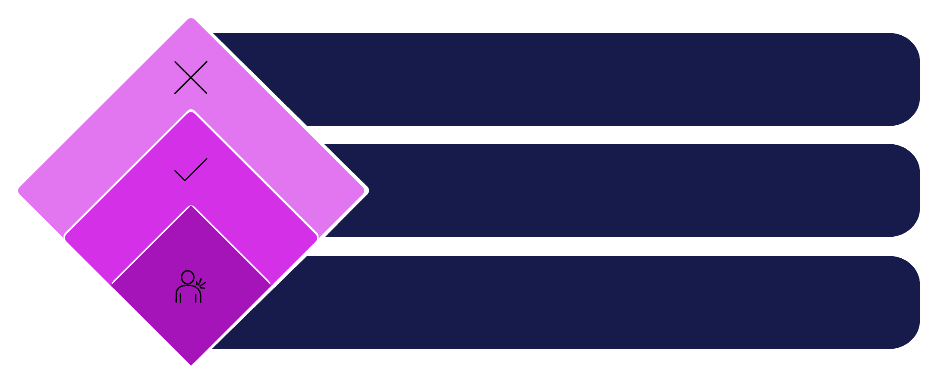




CHAPTER 3
Control Flow: Making Decisions
Conditional Statements
Conditionals let your code make decisions based on specific conditions, executing different blocks of code depending on whether conditions are true or false.
If False
Execute code block B
If True
Execute code block A
Evaluate Condition
Example: Check if age >= 18 to determine voting eligibility
Check if condition is true

Slide 6

Loops: Repeating Actions Efficiently
Loops allow you to execute the same block of code multiple times without writing it repeatedly. Perfect for processing lists or performing repetitive tasks.
1
2
for Loop
while Loop
Best when you know exactly how many times to repeat. Commonly used for counting or iterating through arrays.
Continues as long as a condition remains true. Ideal when the number of iterations isn't predetermined.
let i = 1;
while (i <= 5) {
console.log(i);
i++;
}
for (let i = 1; i <= 5; i++) {
console.log(i);
}

Slide 7
CHAPTER 4
Functions: Reusable Code Blocks
Regular Function Syntax
Key Differences
Functions are reusable blocks of code that perform specific tasks. Define them once, call them anywhere.
Arrow functions don't have their own this context
More compact and modern syntax
Implicit return for single expressions
Preferred in modern JavaScript
function add(a, b) {
return a + b;
}
console.log(add(10, 5)); // 15
Arrow Function Syntax
Arrow functions provide a cleaner, more concise syntax. They're especially useful for short operations.
const add = (a, b) => a + b;
console.log(add(10, 5)); // 15

Slide 8


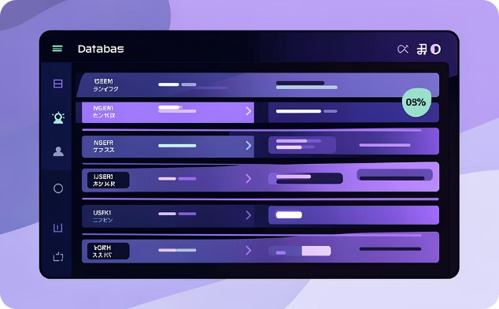
CHAPTER 5
Objects & Arrays: Organising Data
Arrays
Objects
Array of Objects
Store multiple values in a single variable, accessed by numerical index
Store related data in key–value pairs, creating structured information
Combine both concepts for real-world data structures like user lists
let student = {
id: 101,
name: "Rahul",
course: "JavaScript"
};
let users = [
{ id: 1, name: "Amit" },
{ id: 2, name: "Neha" }
];
let languages = ["JavaScript",
"Python", "Java"];
console.log(languages[0]);

Slide 9
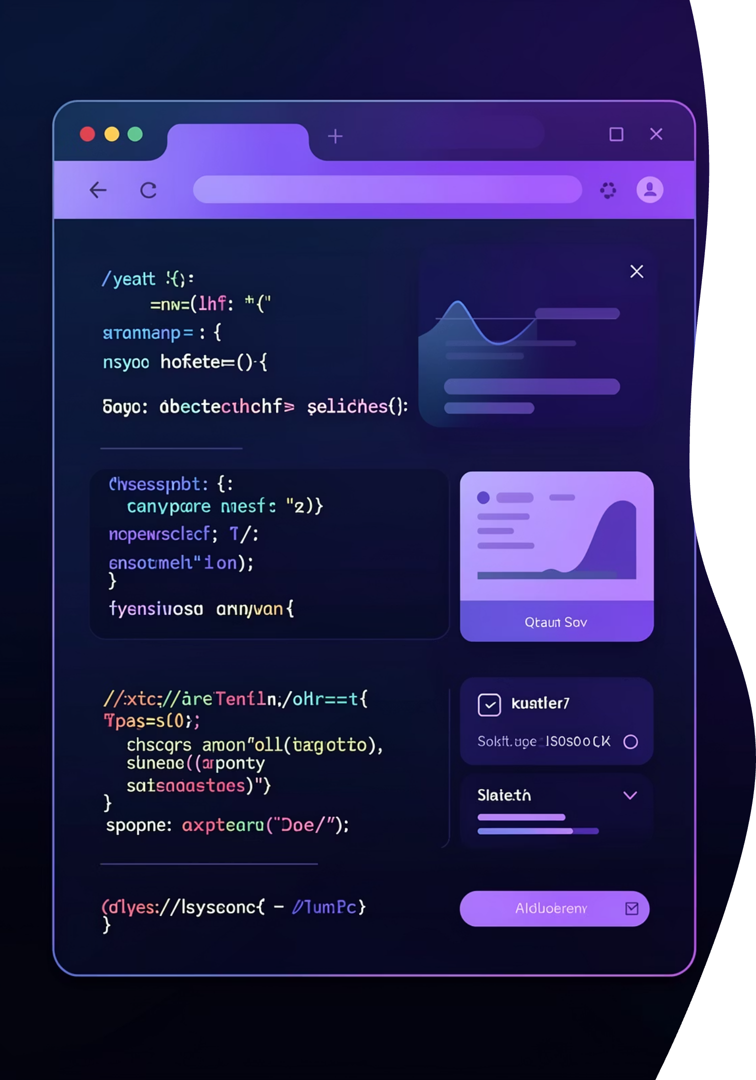
CHAPTER 6
DOM & Events: Interactive Web Pages
Document Object Model
Event Handling
The DOM represents your HTML as JavaScript objects, allowing dynamic manipulation of web page content and styles.
Events capture user actions like clicks, keypresses, or mouse movements, making pages interactive.
let text = document
.getElementById("msg");
text.innerHTML = "Welcome!";
btn.addEventListener("click",
() => {
alert("Clicked!");
});

Slide 10
Quick Reference Guide
Concept
Key Point
let
Block scoped, value can be reassigned
const
Block scoped, value cannot be reassigned
Arrow Function
Modern, concise syntax without own this
Array
Ordered collection accessed by numerical index
Object
Structured data in key–value pairs
DOM
JavaScript interface to manipulate HTML elements
Events
User actions that trigger JavaScript functions
You now have the foundational knowledge to start building interactive JavaScript applications. Practise these concepts regularly to strengthen your understanding!

